Slide 1
CMPS 3500: Calculator
Andrew Mccuan

Slide 2
Python:
Used an object-oriented structure
Used tkinter for the GUI in this calculator (pack() was very difficult to figure out and make look nice)
Used a string to store an expression that will be used in the eval() function that will solve the string. But this can only be used on simple expressions.
For the special case buttons (+/-, exp, ln, sqrt, sq, cos, sin, and tan) eval() can not solve so when a special case button is pressed it will solve the expression in the background and will display it when ‘ENTER’ key is pressed.

Slide 3
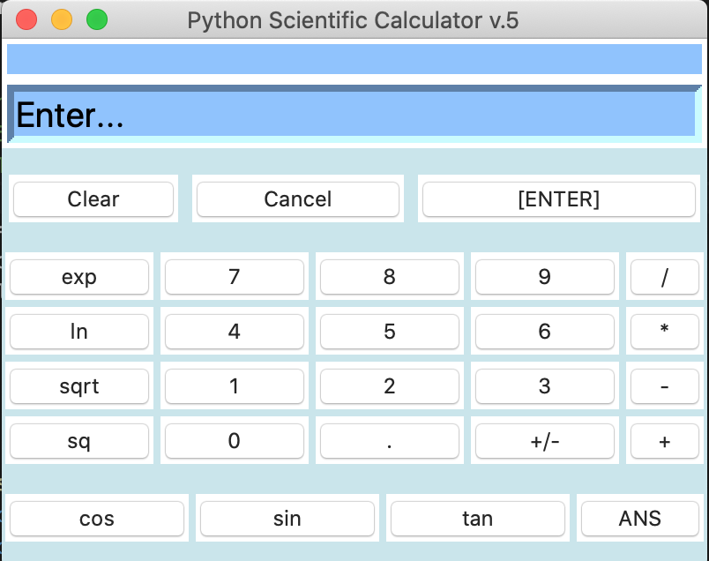
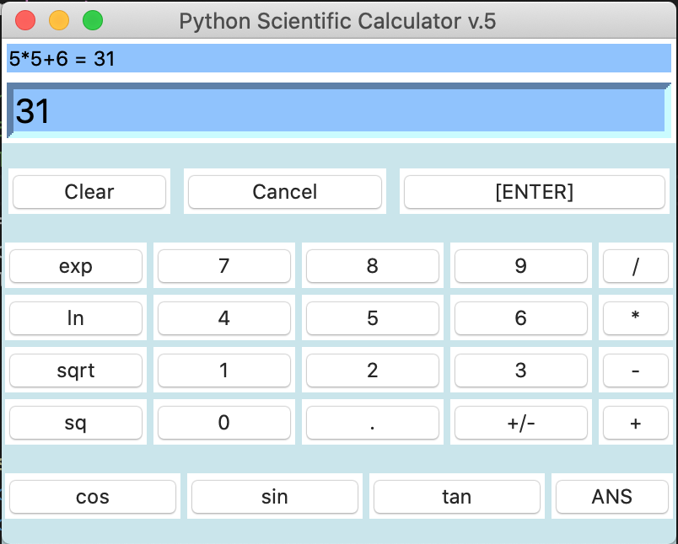
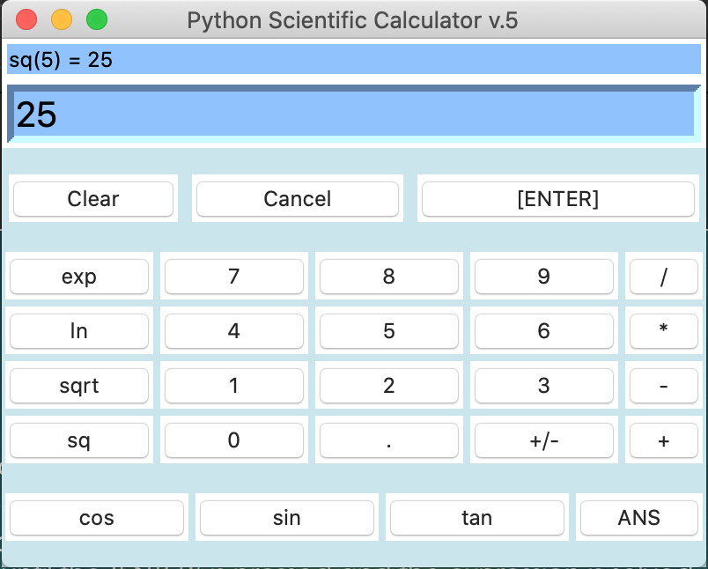
Python:

Slide 4
Perl:
Could not get a GUI to run so used a terminal only interface.
Strategy was to create a while loop for the break case and a switch on the inside so the calculator would not end after one calculation.
Created a function that checks to see if inputs are only numbers 0-9
This program can only take one value in at a time to progress
Basic calculations (+, -, *, /) are done by using ‘eval’ which evaluates a string given.
For the special cases (+/-, exp, ln, sqrt, sq, cos, sin, and tan) they all use their own specific function to evaluate the given expression.

Slide 5
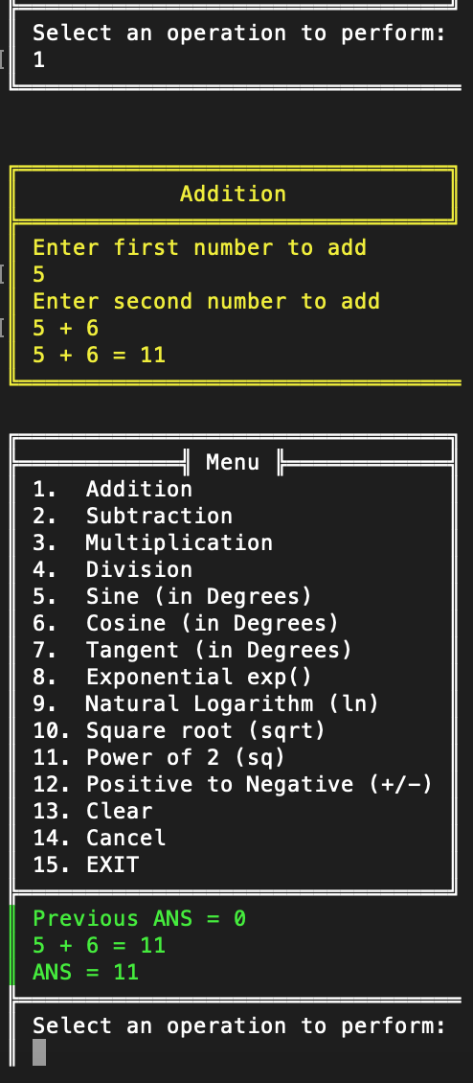
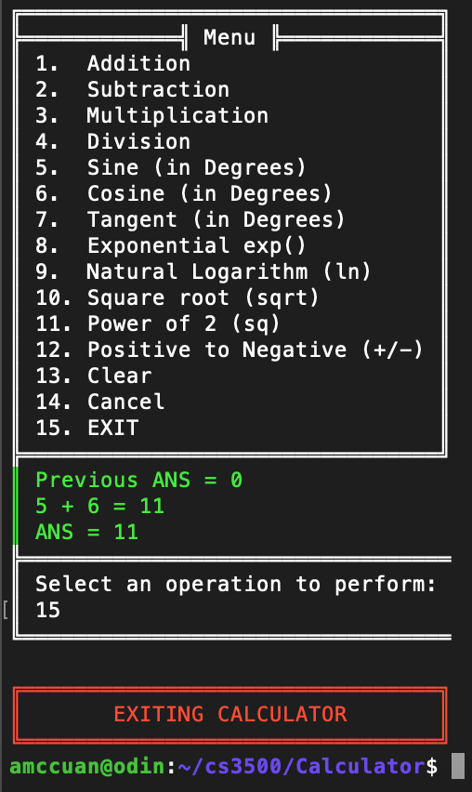
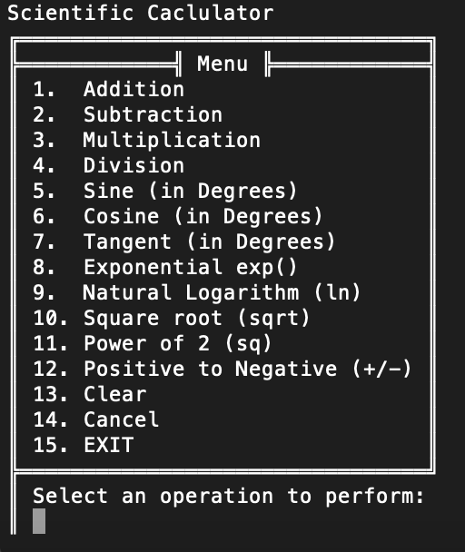
Perl:

Slide 6
Java:
Used an object-oriented structure.
Created a GUI with buttons that send string arguments into a method that determines what button was pressed and stores it in a string until the ‘ENTER’ is pressed and the expression is solved.
Imported a script library to use JavaScript eval() to do calculations because Java does not have a method like this.
For the special case buttons (+/-, exp, ln, sqrt, sq, cos, sin, and tan) these will solve the expression when they are clicked. I could not think of a way to around the eval() and using these specific methods.

Slide 7
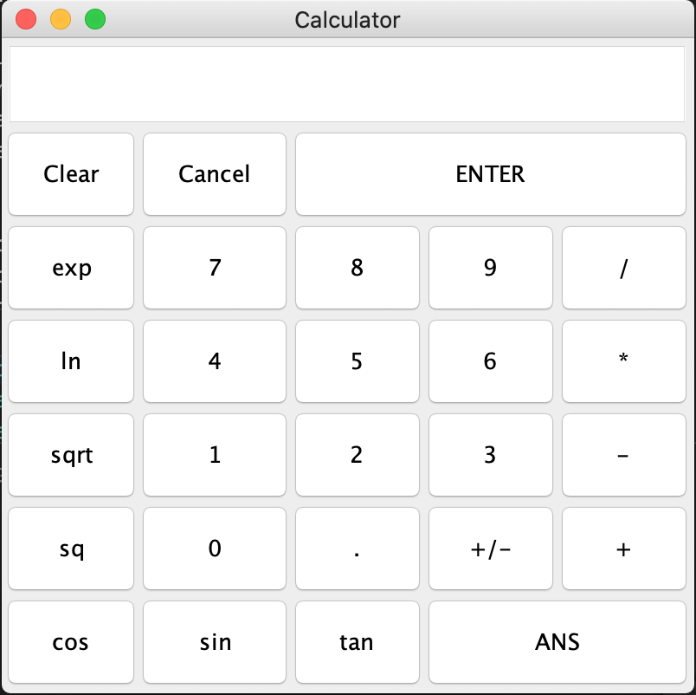
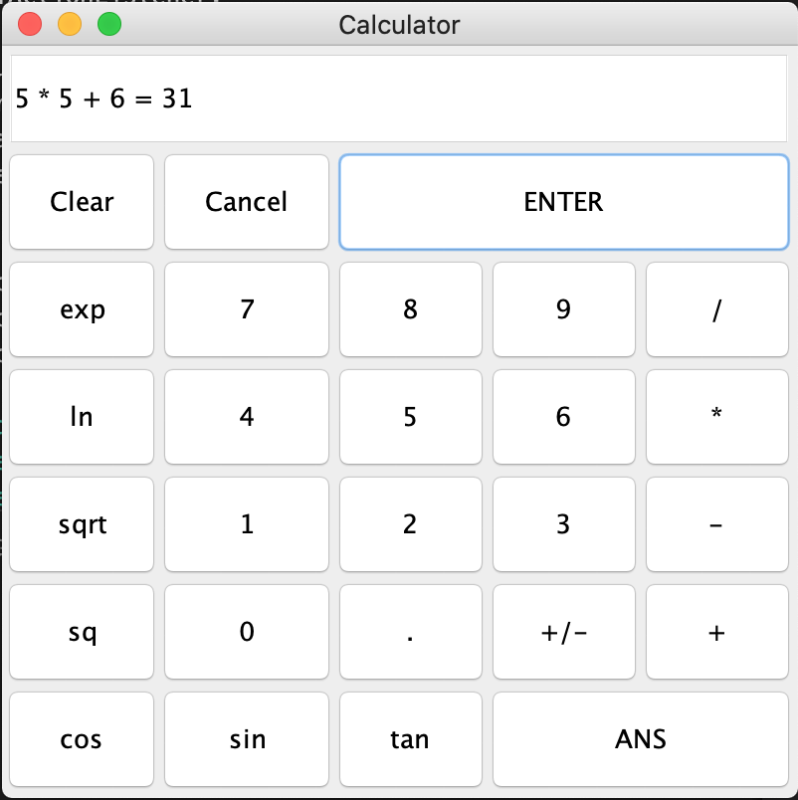
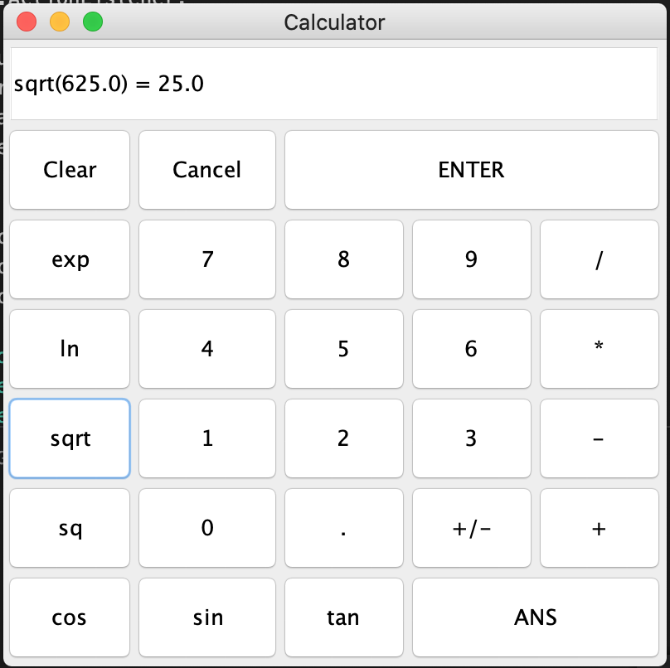
Java:

Slide 8
Conclusion:
I would say this was a great learning experience and how to tackle different ways of creating a calculator because some languages have more limitations than others.
This makes you think of the many ways a user might input calculations in and you must try and limit this uses.
Also I would state that this task become redundant when it came to making the last calculator.

